Slide 1
SPA Assignment Part-1: App for Community Messaging
Group 95
Hrudhay Kolli - 2019AH04040
Narendrababu S - 2019AH04022
Akshat Gupta - 2019AH04001

Slide 2
Assignment Part - 1

Slide 3
Problem Statement
To build a private community app which will allow people to create a specific community and invite other users to join that community. Each community itself should work as a social network.
Any user in any community can
do various types of posts (including text, images, videos) in community that will show up in feed of other users, interact with the posts of other users (like, comment, share etc.).
do conversation with other users via Direct messaging or there can be various user discussion groups within that community where multiple users can do conversations.
To design a scalable solution for the same using Big Data Technologies with the help of the system can efficiently scale to millions/billions of users and fulfill their requests in an efficient way.
To get insights/analytics for further use of organization.

Slide 4
Assumptions
Users can do
1-to-1 messaging
1-to-group messaging
Multiple users can send messages to many different users or groups simultaneously.
Data centers infrastructure are in place to store and use the data for further analytics.
Communities and respective groups are already present into which the users join and perform the action.

Slide 5






High Level Architecture of the System
Apache Zookeeper
Service Configuration & Coordination
Topic: Post
Stream Processing
Consumers
(Data Access tier)
Web App
Mobile App
User
Topic: Like
Topic: Comment
NoSQL
MySQL/
Cassandra / MangoDB
Community
Topic: Share
Storage
Layer
Topic: Direct Message
Producers
Collection tier
Web App
Mobile App
WebSocket APIs
Cloud Gateways
Message Queuing Tier
Analysis / Processing Tier
Apache Kafka
Apache Spark
(PySpark)
Tableau, Power BI,
Web/thick clients
Analytics &
Visualization

Slide 6
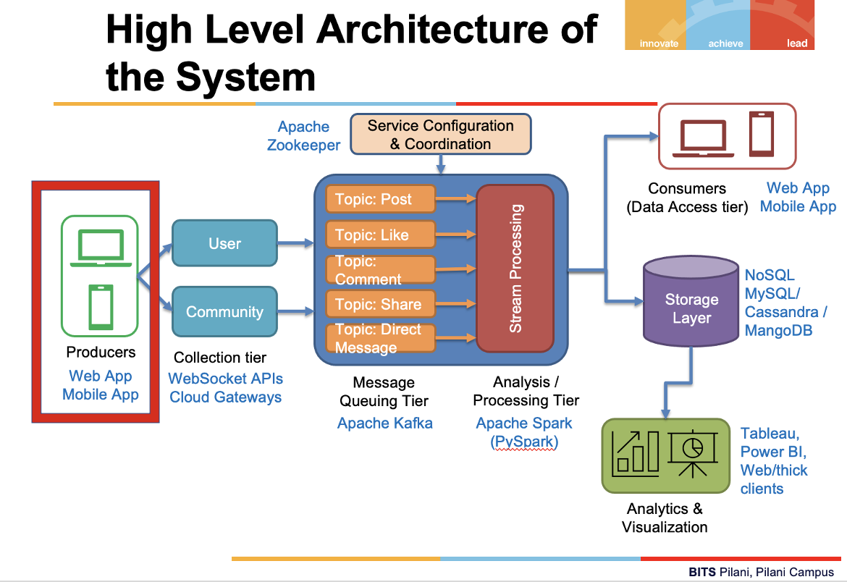
Different Components of the System
Producers:
In the proposed system the producers are the users of the community messaging app.
The users will use the web app or mobile app to produce data
The data (messages) can be in the form of
text, images or videos
The user can send the messages
To another user
To a community / group
The messages can be
A New message to a single user or to a group
Response to an earlier message to a user or in a group

Slide 7
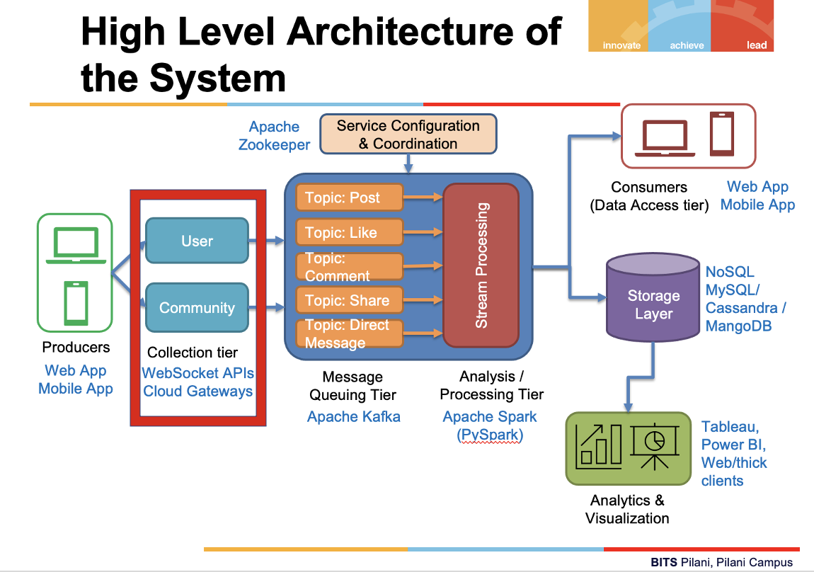
Different Components of the System
Data Collection Tier:
General Capabilities:
Managing the connection to the Meetup API
Ensuring that we don’t lose data
Integrating with the message queuing tier
Collection tier is the entry point for bringing data into the streaming system.
Interaction patterns
Request/acknowledge pattern : 1-to-1 user interactions
Publish/subscribe pattern: 1-to-group interactions
Scaling the interaction patterns
By Load balancer
Buffering layer
Implementing fault tolerance
Hybrid message logging (HML)

Slide 8
Incoming data assumption
user_action {
'action_id': <Action id such as 1 for post, 2 for like etc>
'action_name': <Action name such as POST, LIKE etc>
'action_reference_id': <A unique id created for the action>
'user_id': <User ID>
'user_name': <User Name>
'group_id': <Group ID>
'group_name': <Group Name>
'group_description': <Group Description>
'community_id': <Community ID>
‘community_name’: <Community Name>
'community_description': <Community Description>
'action_data_id': <User action id like 1TEXT for a textual post, 1IMAGE for an image post etc>
'action_description': <Describing the action like ‘POST_TEXT’ for a textual post>
'action_data': <The data of the post or like that will be generated by default>
'timestamp': <Action 'timestamp'>
}

Slide 9
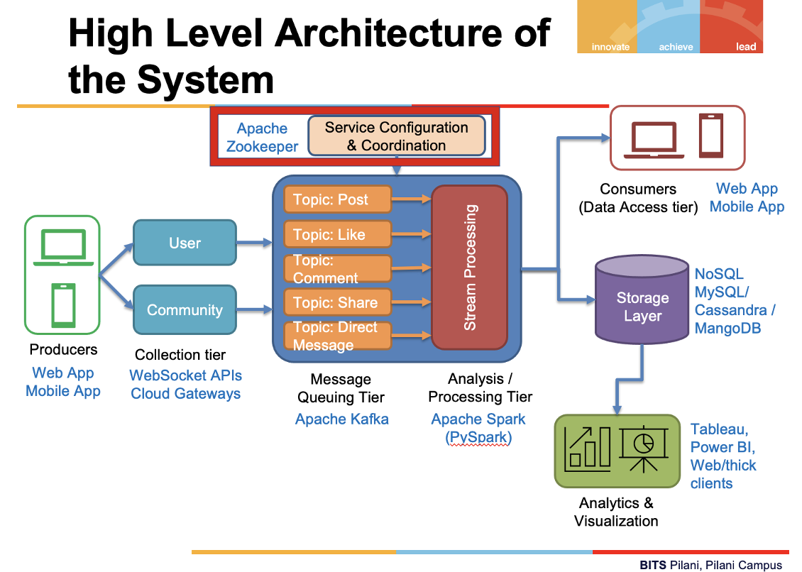
Different Components of the System
Service Configuration and Coordination:
Managing the requirements in a distributed environment is a difficult problem, often leading to incorrect server behavior. This leads directly to the motivation behind configuration and coordination systems: providing a system-wide service that correctly and reliably implements distributed configuration and coordination primitives.
Apache Zookeeper is such a component in a streaming system

Slide 10
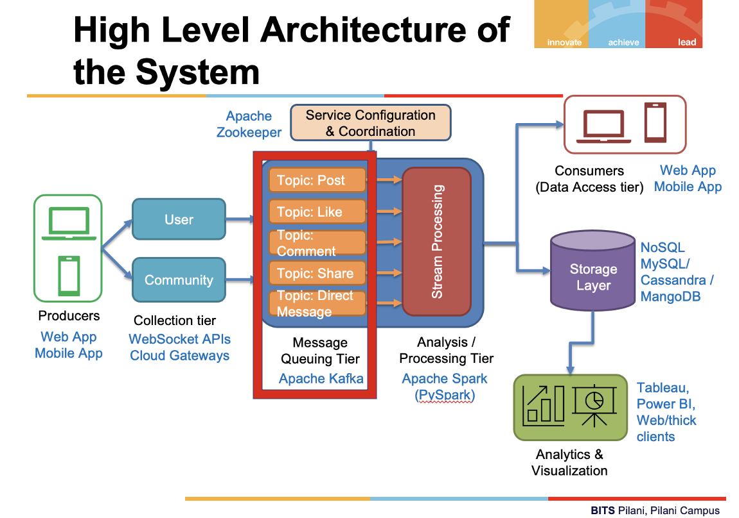
Different Components of the System
Message Queuing Tier
The collection tier is decoupled from the analytics tier which allows the tiers to work at a higher level of abstraction, by passing messages and not having explicit calls to the next layer
We can use Apache Kafka as the messaging broker between the producers and consumers.
Kafka is a high-performance systems with sufficient scalability to support real-time streaming.

Slide 11
Different Components of the System
Message Queuing Tier
Topics in Kafka are the logical grouping that messages are written to and read from. A producer sends messages to a broker for a particular topic, and the consumer requests to read data from a particular topic.
Kafka topics in the proposed system
Post
Like
Comment
Share
Direct message
We can add partitions and replications to each of the topic to ensure high availability

Slide 12
4 main reasons why we chose Kafka:
Kafka is highly scalable. Kafka is a distributed system, which is able to be scaled quickly and easily without incurring any downtime. Apache Kafka is able to handle many terabytes of data without incurring much at all in the way of overhead.
Kafka is highly durable. Kafka persists the messages on the disks, which provides intra-cluster replication. This makes for a highly durable messaging system.
Kafka is highly reliable. Kafka replicates data and is able to support multiple subscribers. Additionally, it automatically balances consumers in the event of failure. That means that it’s more reliable than similar messaging services available.
Kafka offers high performance. Kafka delivers high throughput for both publishing and subscribing, utilizing disk structures that are capable of offering constant levels of performance, even when dealing with many terabytes of stored messages.

Slide 13
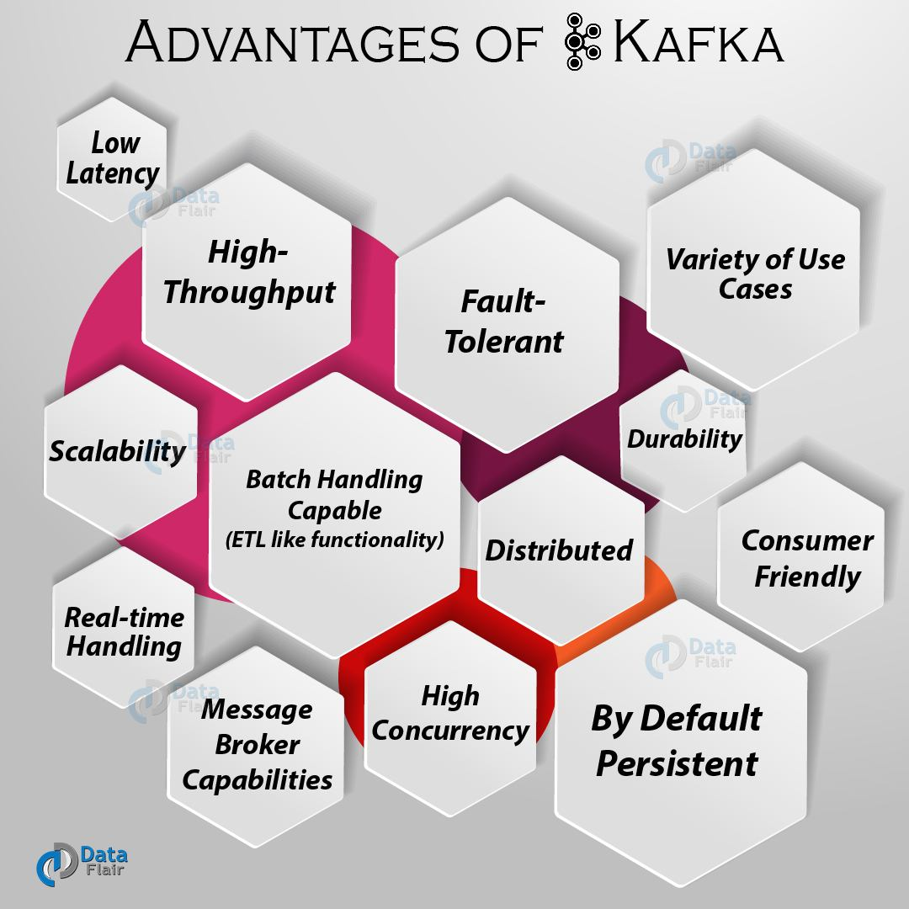

Slide 14
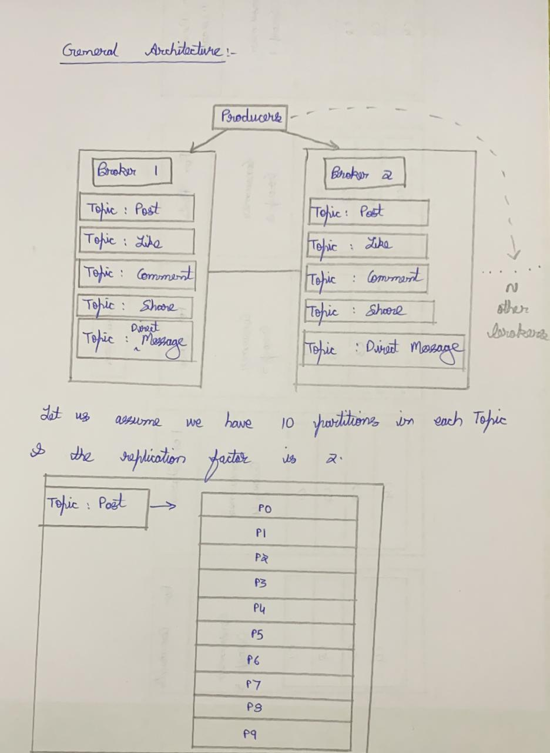

Slide 15
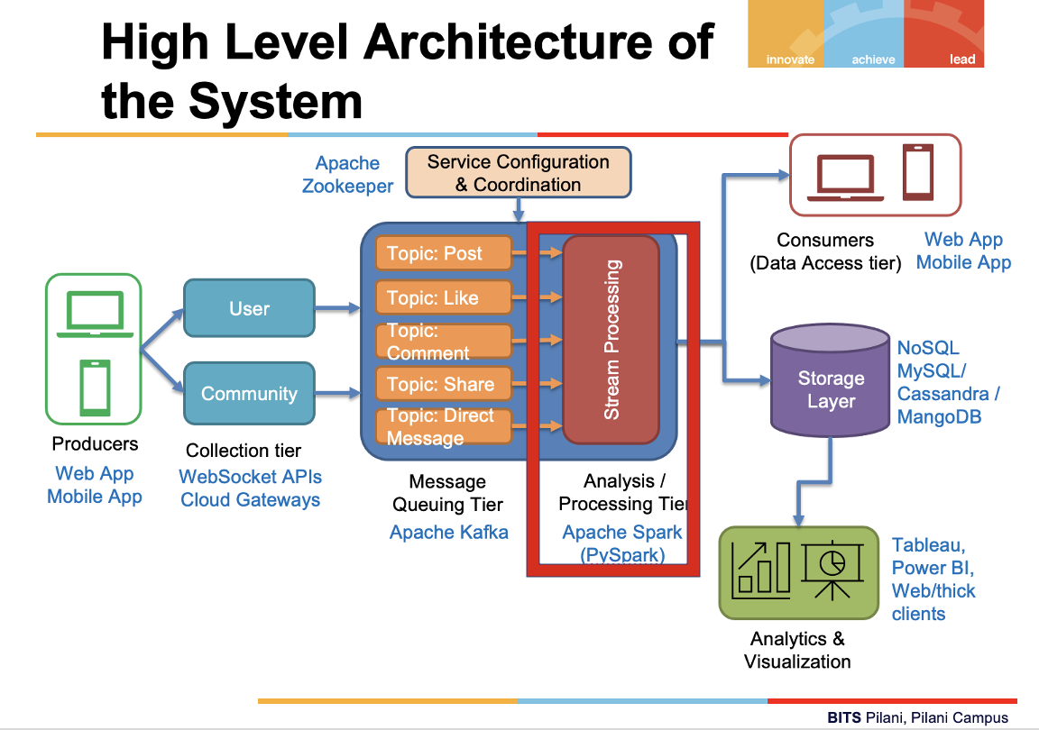
Different Components of the System
Analysis or Processing tier:
A specialized form of parallel computing, designed to handle the case where data may be processed only one time.
The core of any streaming framework is some sort of coordination server. This coordination server stores information about the topology of the process – by ZooKeeper
The topology is Spark’s mechanism for computational organization and is represented by Directed Acyclic Graph (DAG).

Slide 16
Reasons why we chose Apache Spark:
Fast Processing Speed: The first and foremost advantage of using Apache Spark for your big data is that it offers 100x faster in memory and 10x faster on the disk in Hadoop clusters.
Supports a variety of programming languages: Spark applications can be implemented in a variety of languages like Scala, R, Python, Java, and Clojure. This makes it easy for developers to work according to their preferences.
Powerful Libraries: It contains more than just map and reduce functions. It contains libraries SQL and dataframes, MLlib (for machine learning), GraphX, and Spark streaming which offer powerful tools for data analytics.
Near real-time processing: Spark has MapReduce that can process data stored in Hadoop and it also has Spark Streaming which can handle data in real-time.
Compatibility: Spark can run on Hadoop, Apache Mesos, Kubernetes, standalone, or in the cloud. It can operate diverse data sources.

Slide 17
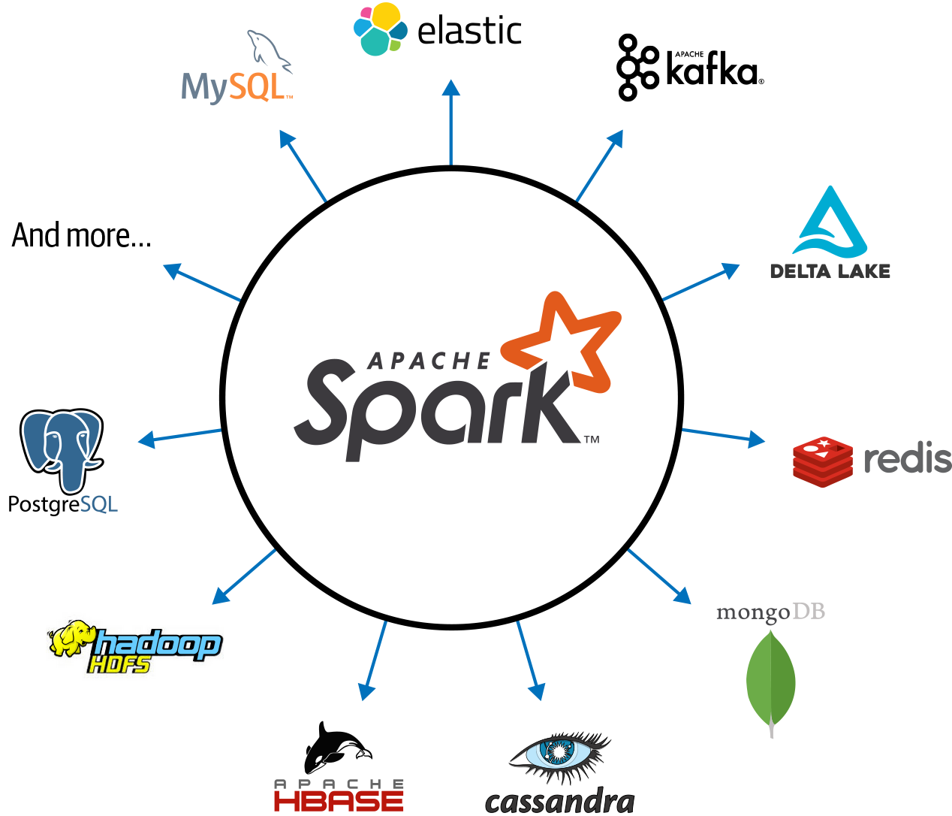

Slide 18
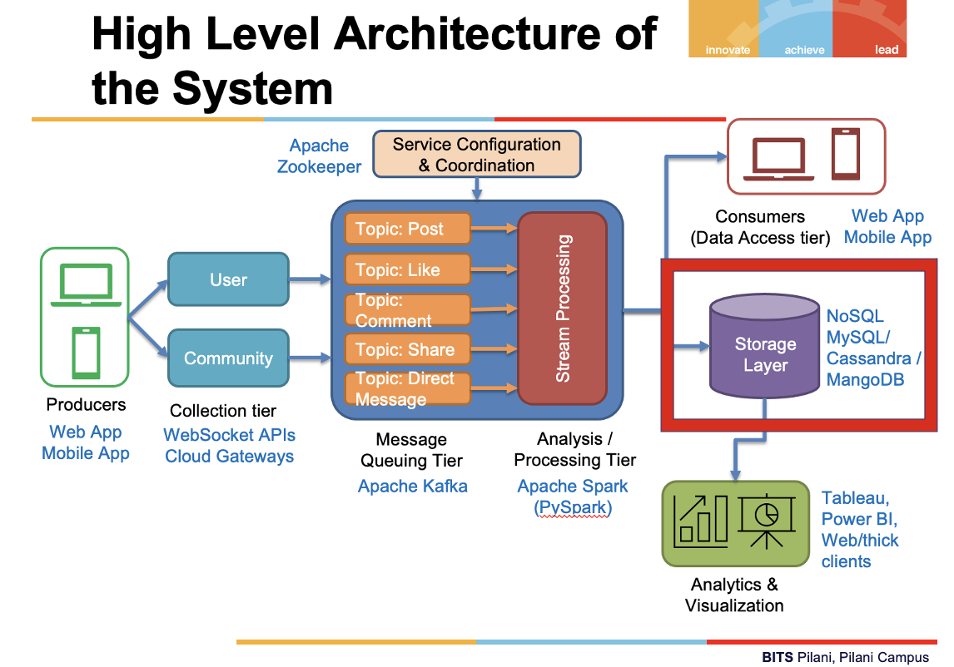
Different Components of the System
Storage Layer:
High-performance reads and writes, usually at the expense of the usual requirements of a transactional database, the complexity of the queries.
MYSQL as the primary database management system for all the structured data storage such as the different wall posts, information of the various users, their timeline and so on.
Cassandra can be used as a decentralized database system that takes features from both key-value stores and tabular databases can be used for huge amounts of data structure that extends to different commodity servers. It also provides high-quality service that is available without failure.
Other solutions like MangoDB can also be used which give high performance on the search queries.

Slide 19
We are using MongoDB for the following reasons:
Schema less − MongoDB is a document database in which one collection holds different documents. Number of fields, content and size of the document can differ from one document to another.
Structure of a single object is clear.
No complex joins.
Deep query-ability. MongoDB supports dynamic queries on documents using a document-based query language that's nearly as powerful as SQL.
Tuning.
Ease of scale-out − MongoDB is easy to scale.
Conversion/mapping of application objects to database objects not needed.
Uses internal memory for storing the (windowed) working set, enabling faster access of data.

Slide 20
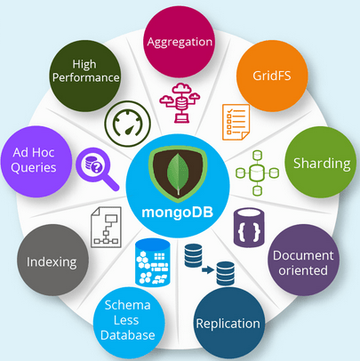

Slide 21
Data storage assumption
Let us assume the data is stored as the following key, value pairs:
'users' :
'user_id'
'user_name'
‘communities’:
'user_id'
'action_id'
'community_id'
'community_name'
'community_description'
‘groups’:
'user_id'
'action_id'
'group_id'
'group_name'
'group_description'
‘friends’:
'user_id'
'friend_id'
‘actions’:
'user_id'
'action_id'
'action_name'
'is_owner'
'action_owner_id'
'receiver_id' (for direct messages)
'timestamp'
‘posts’:
'action_id'
'action_name'
'action_description'
'action_data'
‘likes’:
'action_id'
'action_name'
'action_description'
'action_data'
‘comments’:
'action_id'
'action_name'
'action_description'
'action_data'
‘shares’:
'action_id'
'action_name'
'action_description'
'action_data'
‘direct_messages’:
'action_id'
'action_name'
'action_description'
'action_data'

Slide 22
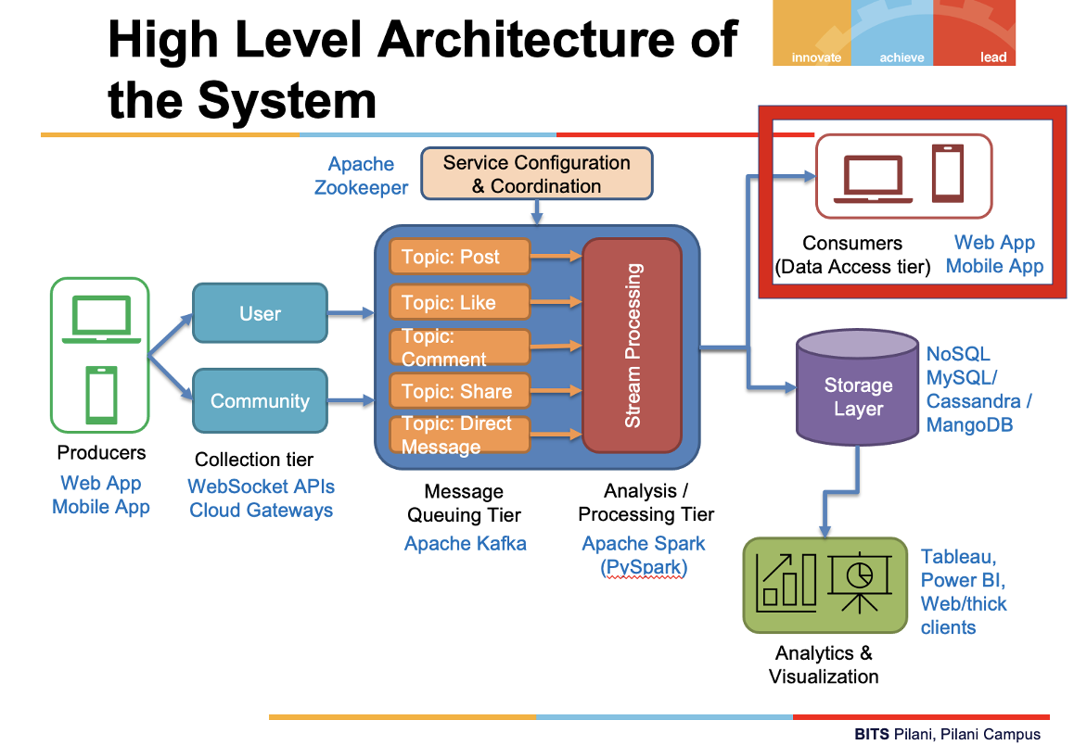
Different Components of the System
Consumers (Data Access Tier):
After streaming data has been collected, processed, and stored, it is time to deliver this data to end users. This is where we make it available for a UI. The data access tier tie together the connected channel with what turns out to be a Kafka consumer.
We can also use a Bootstrap 3 framework. This is a lightweight framework that integrates well with jQuery and provides easy integration of mobile features.
The end users will use the web app or mobile app to consume the data

Slide 23
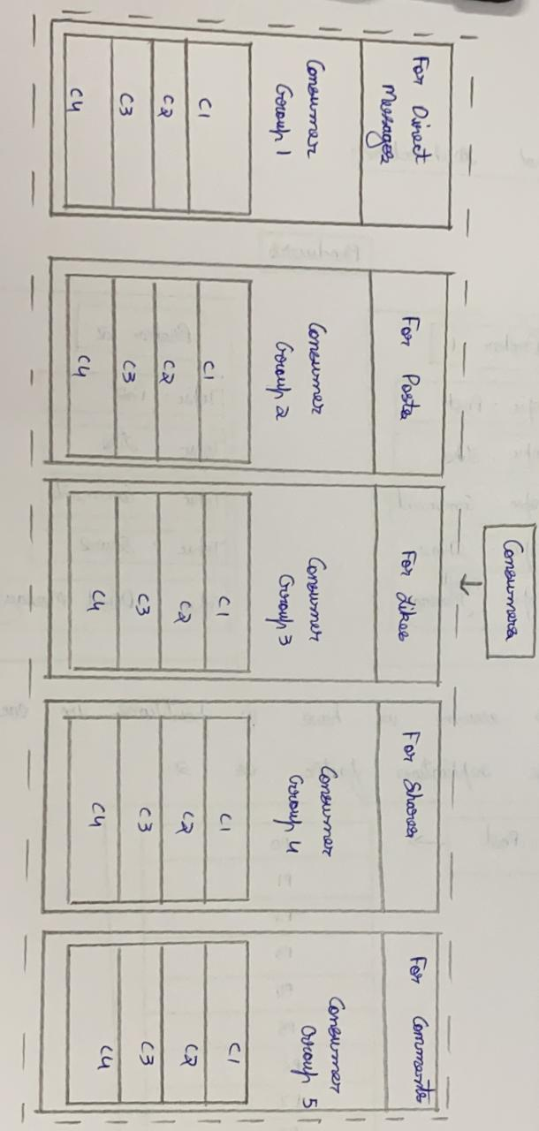

Slide 24
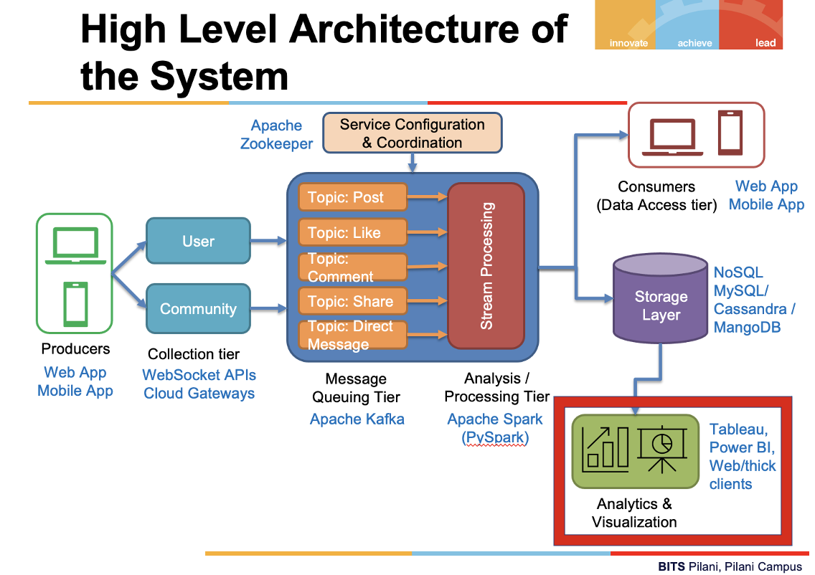
Different Components of the System
Analytics & Visualization
This dashboard application has a single index view that renders all the metrics to be displayed in the dashboard. A typical dashboard consists of a variety of small panels that contain metrics or visualizations.
We can have KPI’s of the system
Message update frequency
Direction of communication
Message latency
Efficiency
Fault tolerance/reliability
We can use Tableau or Power BI as the Visualization tools to view the KPI’s

Slide 25
Let us consider an example:
Let us consider the data that is being generated will be divided into different topics which are post, like, comment, share, direct message. These topics are then divided into partitions. Let us assume each kind of post has a unique id, each user has a unique id.
Based on the unique post id and unique user id, the data will be stored in the respective partitions.
The data will be divided into partitions based on the action like post, like etc and user id. This is done so that by default, the partition key is passed through a hashing function, which creates the partition assignment. That assures that all records produced with the same key will arrive at the same partition. Specifying a partition key enables keeping related events together in the same partition and in the exact order in which they were sent.
Ex: Let text post have a unique id of '1TEXT' and the user posted have 'Abdul_Kalam_abdul_kalam1@gmail.com' as user id.
Let us consider that a user 'Abdul Kalam' posts about his latest job "Happy to share that Im joining Google as Software Engineer !!!!".

Slide 26
Cont.
The data that is generated in JSON format.
user_action {
'action_id': 1
'action_name': POST
'action_reference_id': 1275276452465
'user_id': 'Abdul_Kalam_abdul_kalam1@gmail.com'
'user_name': 'Abdul Kalam'
'group_id': 100045
'group_name': 'My Job Status'
'group_description': 'Group in which we can post anything about our job.'
'community_id': 200056
communtiy_name: 'Job Community'
'community_description': 'Community in which there are multiple groups for job search, sharing information about jobs etc.'
''action_data'_id': '1TEXT'
'action_description': 'POST_TEXT'
'action_data': 'Happy to share that Im joining Google as Software Engineer !!!!'
'timestamp': '2021-07-21 16:10:05'
}

Slide 27
Cont.
Now this will be considered under post topic, partition p0. Let us consider that this is the first post and hence the offset for this data is 1 in the respective partition.
Now this data will be sent to processing and will be stored in the form of documents in our database.
MongoDB documents are formatted in BSON (an extended Binary form of JSON) , which provides us ultimate flexibility in structuring data of all types.
Let us assume the multiple keys are users, communities, groups, actions, posts, friends, likes, comments, shares, direct_messages. Now our above considered data point will be stored in users, communities, groups, actions, posts keys with data as respective values.
{"_id": ObjectId("5ce45d7606444f199acfba1e"),
'users' :{
'user_id': 'Abdul_Kalam_abdul_kalam1@gmail.com'
'user_name': 'Abdul Kalam’}
‘communities':{
'user_id': 'Abdul_Kalam_abdul_kalam1@gmail.com'
'action_reference_id': 1275276452465
'community_id': 200056
'community_name' : 'Job Community'
'community_description': 'Community in which there are multiple groups for job search, sharing information about jobs etc.'}
‘groups’:{
'user_id': 'Abdul_Kalam_abdul_kalam1@gmail.com'
'action_reference_id': 1275276452465
'group_id': 100045
'group_name': 'My Job Status'
'group_description': 'Group in which we can post anything about our job.'}
‘actions’:{
'user_id': 'Abdul_Kalam_abdul_kalam1@gmail.com'
'action_id': 1
'action_reference_id': 1275276452465
''action_data'_id': '1TEXT'
'action_name': 'POST'
'is_owner': 'YES'
'action_owner_id': 'Abdul_Kalam_abdul_kalam1@gmail.com'
'receiver_id': 'NONE'
'timestamp': '2021-07-21 16:10:05’}
‘posts’:{
'action_reference_id': 1275276452465
'action_name': 'POST'
'action_description': 'POST_TEXT'
'action_data': 'hoy8ghIUGAYIGHYGHQUOhouhoihoiJHUHOIHIJOIj696479874208408y'(Encrypted text) }}

Slide 28
Video for Part-1
https://drive.google.com/file/d/1dqGg_zoCXJwD6JYQidb1D7any3YTxMsy/view?usp=sharing

Slide 29
Assignment Part - 2

Slide 30
Note
The code files, log files, respective screenshots, video recording are uploaded along with this document.

Slide 31
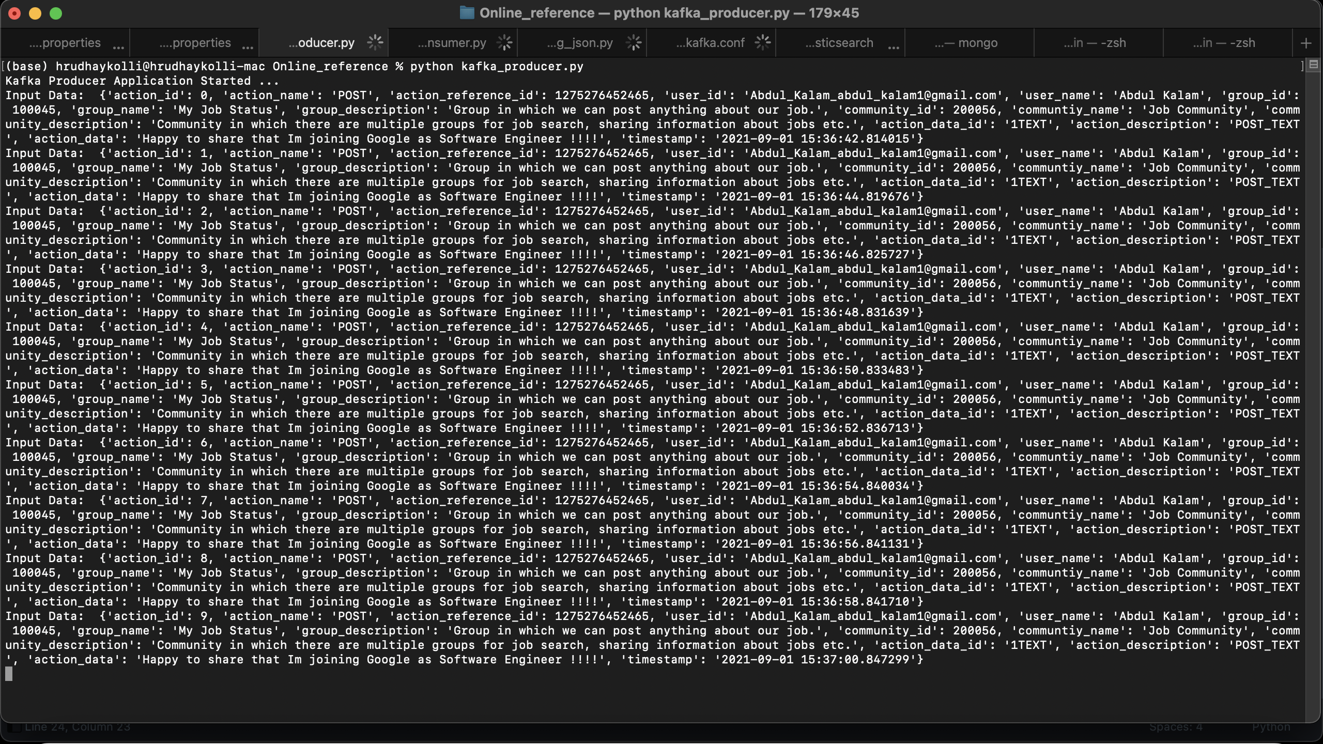
Producer (Kafka)

Slide 32
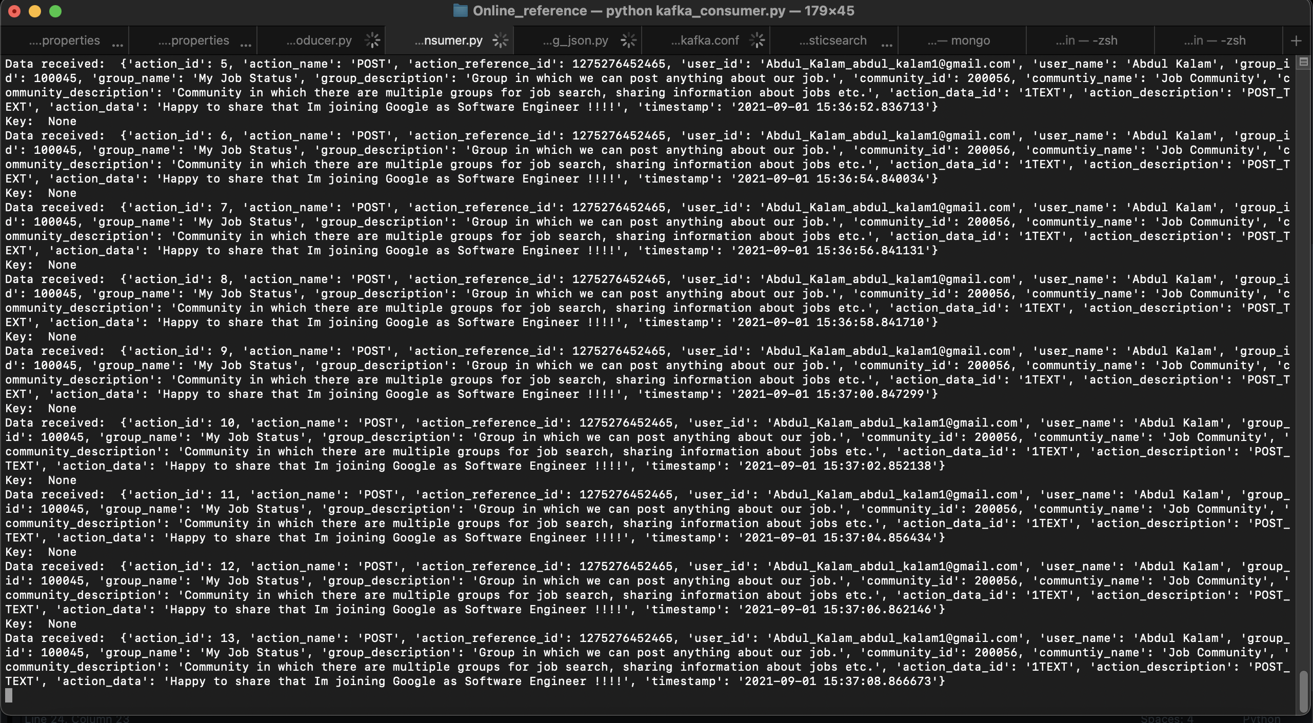
Consumer (Kafka)

Slide 33
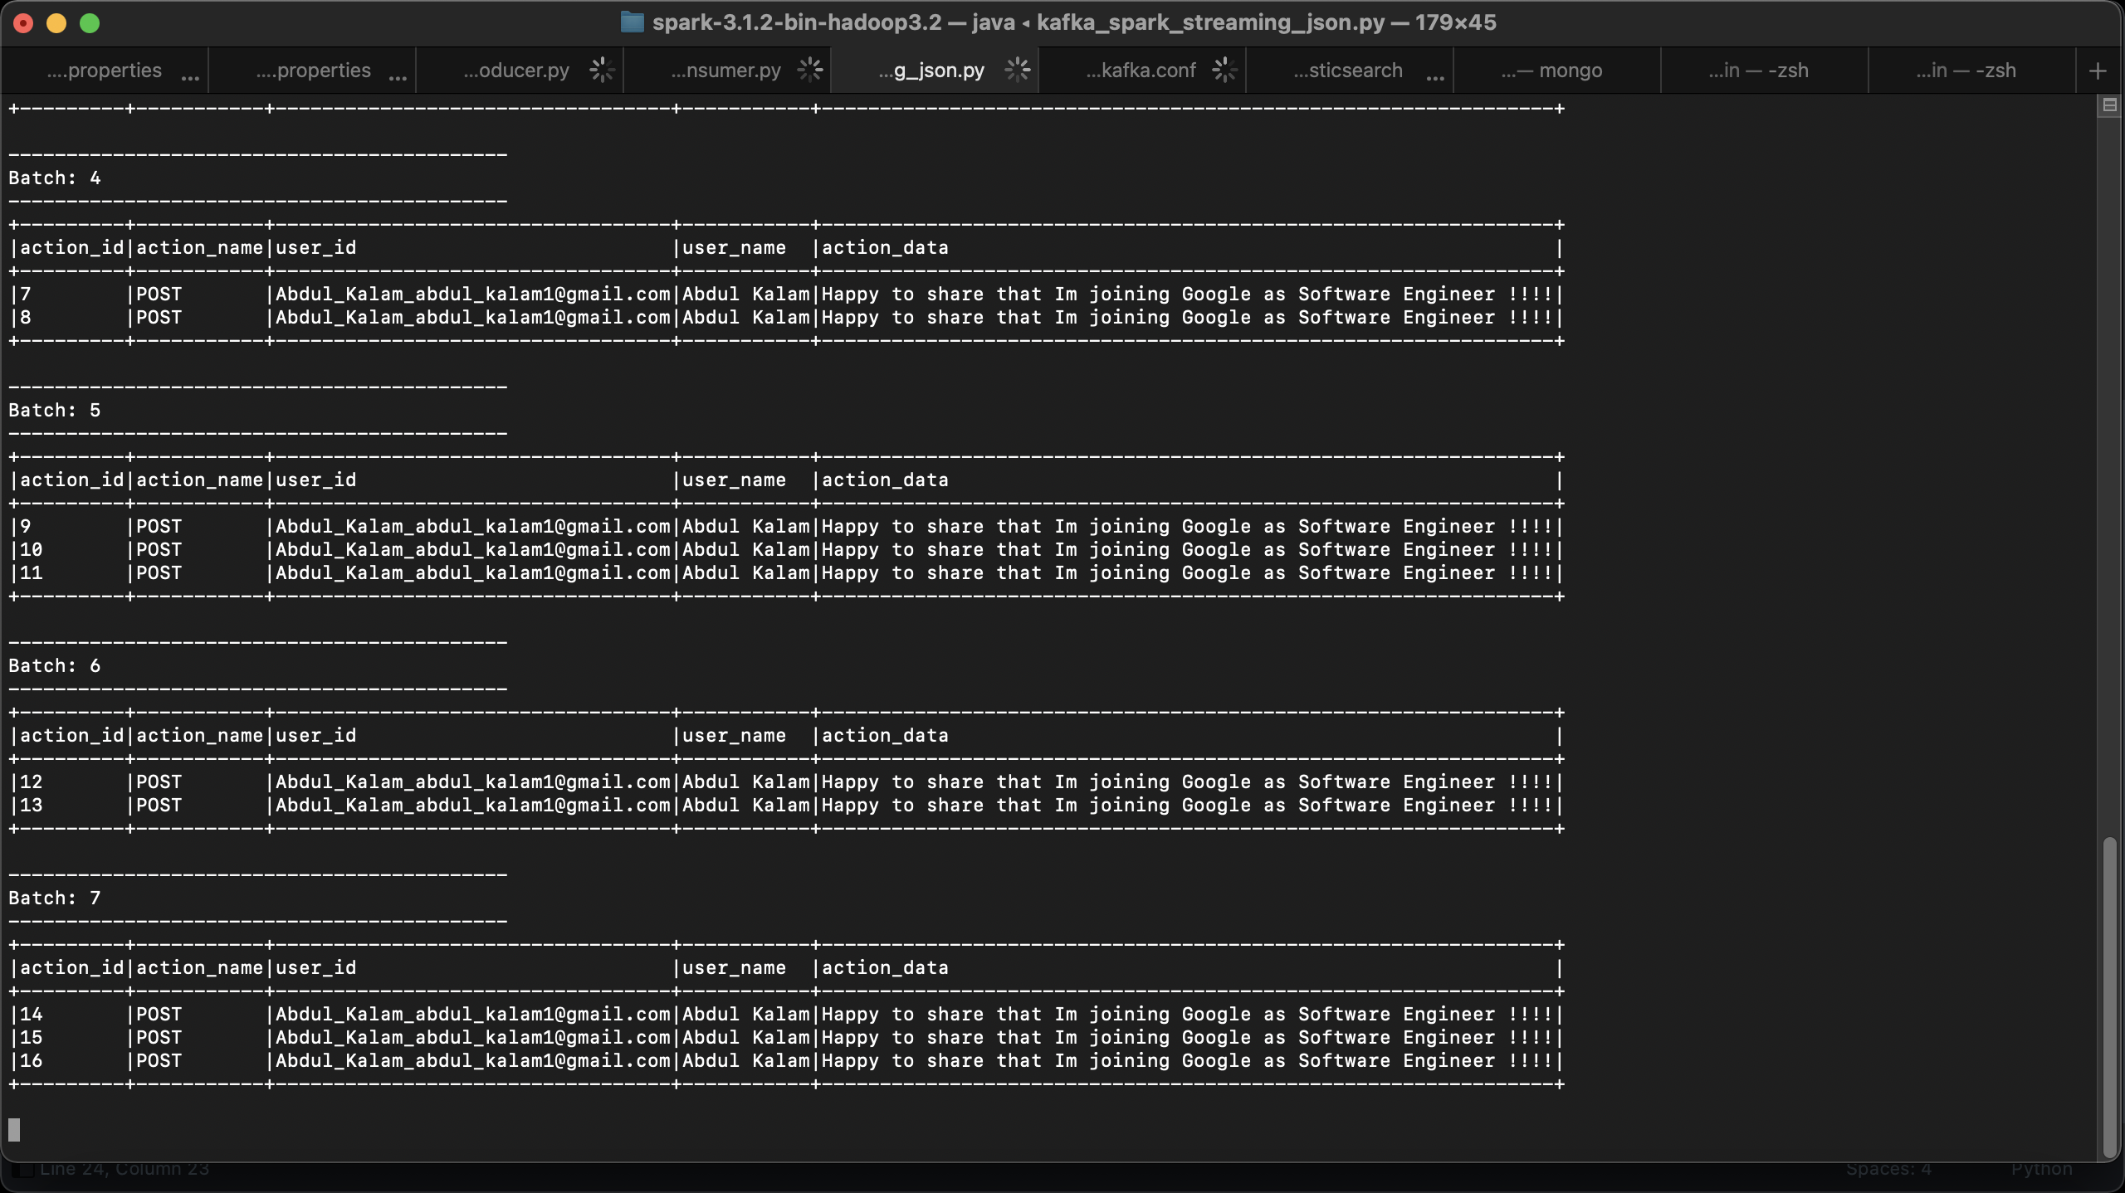
Spark Streaming (SQL)

Slide 34
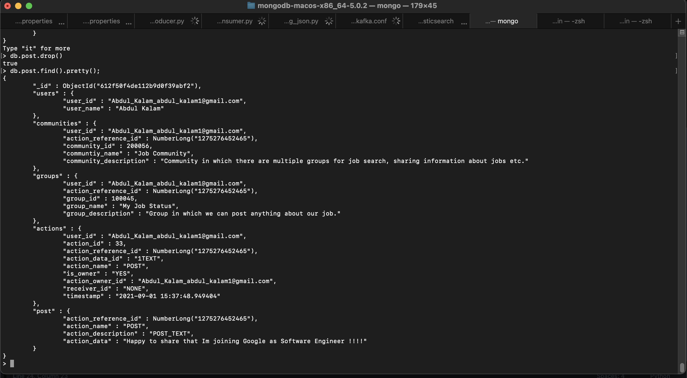
MongoDB

Slide 35
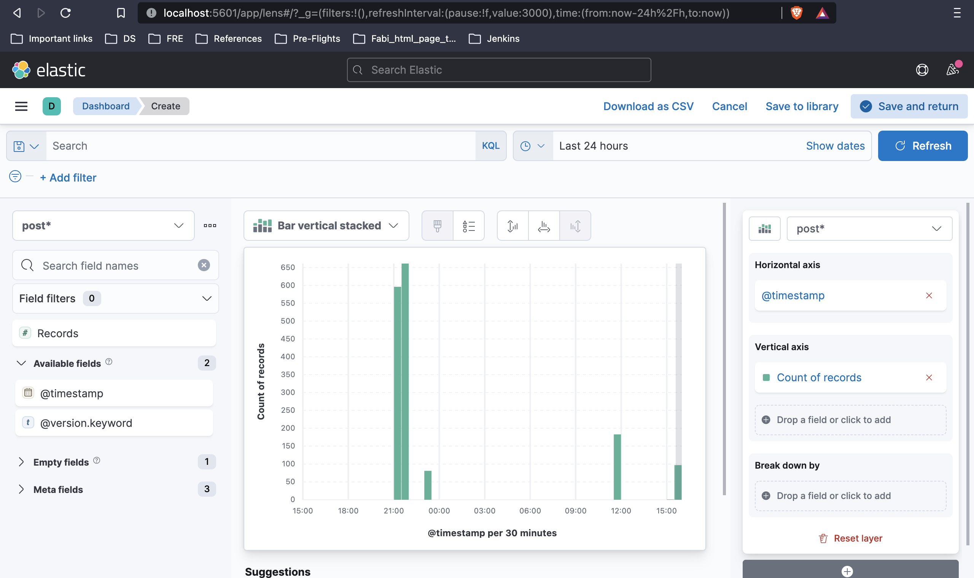
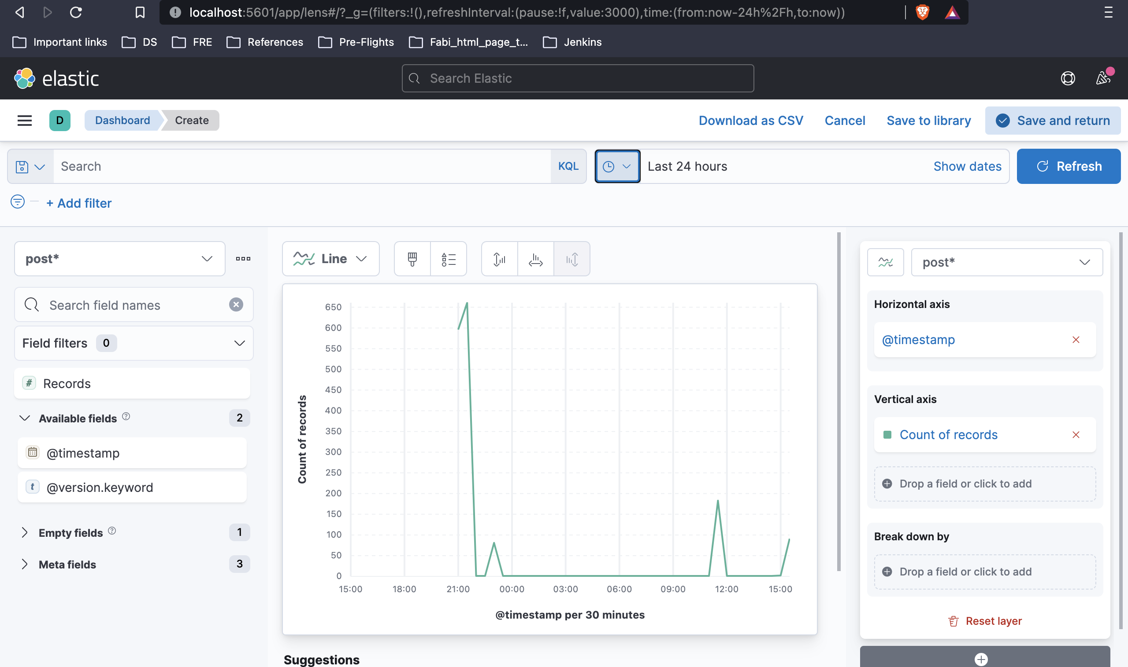
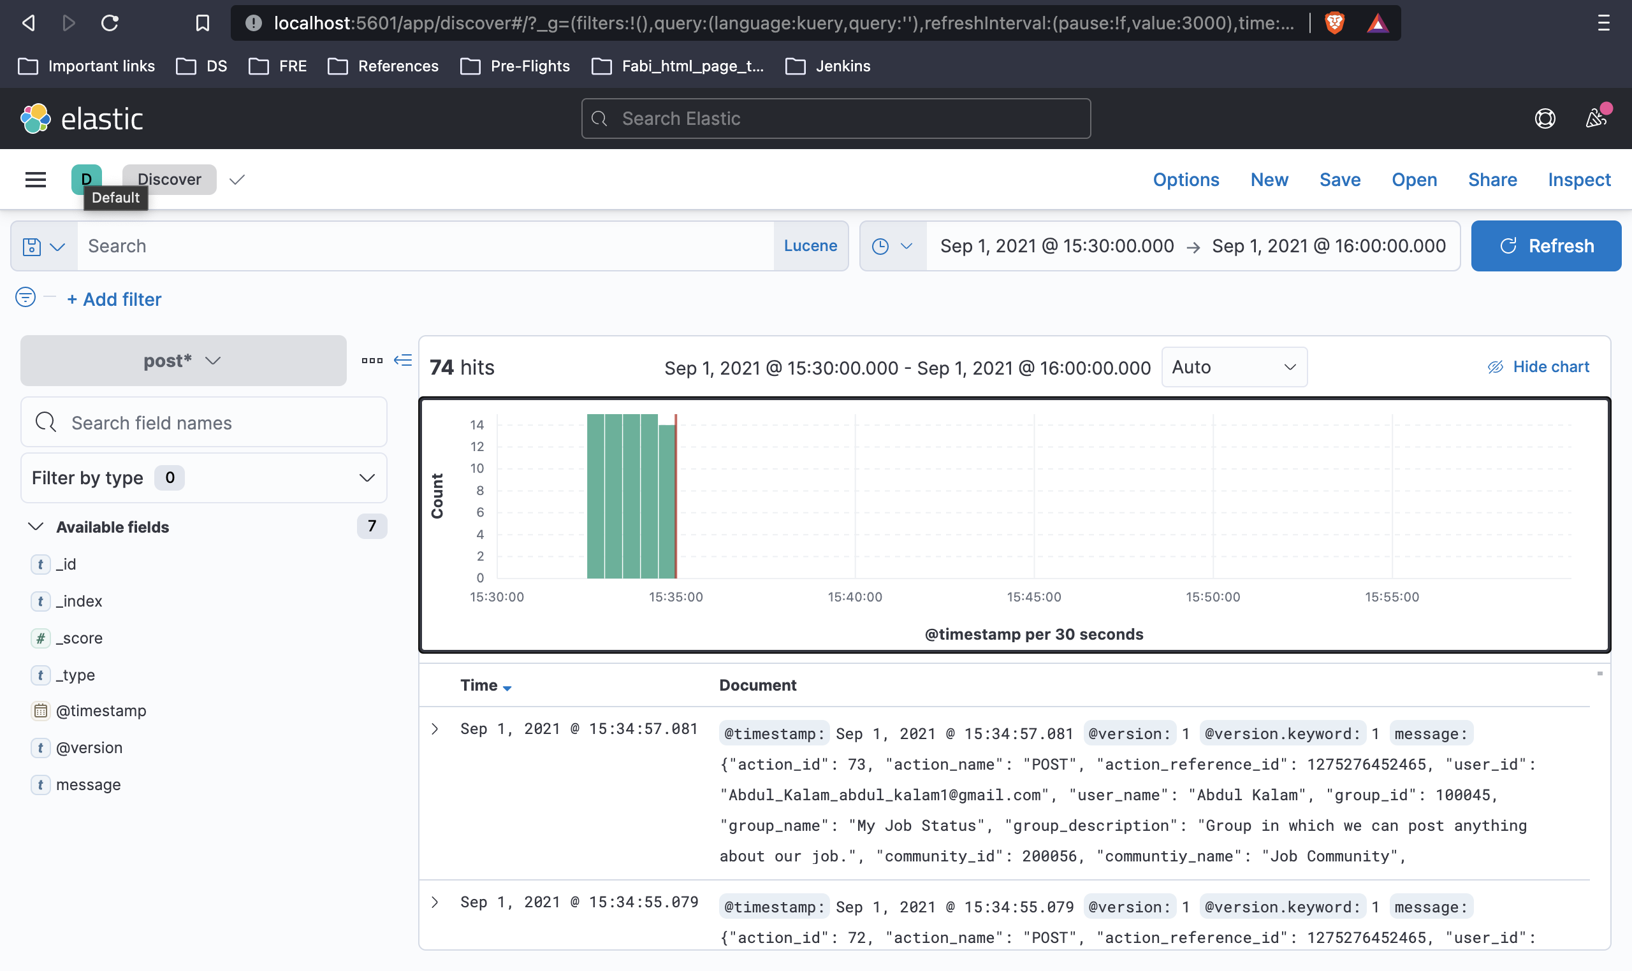
Dashboard (Kibana)

Slide 36
Video for Part-2
https://drive.google.com/file/d/1ReKSMAwf92_Sw1NkF9BvP-2wlnXUWZGQ/view?usp=sharing

